Slide 1





Welcome

Slide 2


Introduction to RISC
Since the development of the stored program computer around 1950, there are few innovations in the area of computer organization and architecture. Some of the major developments are:
The Family Concept (1964)
Microprogrammed Control Unit (1951)
Cache Memory (1968)
Pipelining
Multiple Processor

Slide 3
Introduction to RISC
The computer designers intend to reduce this gap (i.e., semantic and high level programming languages) and include large instruction set, more addressing mode and various HLL statements implemented in hardware.
As a result the instruction set becomes complex. Such complex instruction sets are intended to:
Ease the task of the compiler writer.
Improve execution efficiency, because complex sequences of operations can be implemented in microcode.
Provide support for even more complex and sophisticated HLLs.

Slide 4
Introduction to Complex Instruction Set Computer (CISC)
The instruction execution characteristics involves the following aspects of computation:
Operation Performed
Operand Used
Execution sequencing

Slide 5
Introduction to Complex Instruction Set Computer (CISC)
A large number of general purpose registers, or the use of compiler technology to optimize register usage.
A limited and simple instruction set.
An emphasis on optimizing the instruction pipeline

Slide 6
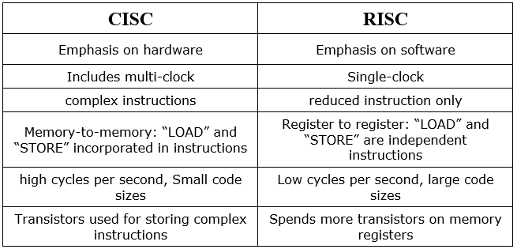
Comparison of RISC & CISC

Slide 7
Characteristics of Reduced Instruction Set Architecture (RISC)
Certain common characteristics are :
One instruction per cycle.
Register–to–register operations.
Simple addressing modes.
Simple instruction formats.

Slide 8
Design Issues of RISC
1. The use of a large register file:
Two basic approaches are possible, one is based on software and the other on hardware.
The software approach
The hardware approach

Slide 9
Design Issues of RISC (Cont’d…..)
2. Register Window:
The use of a large set of registers should decrease the need to access memory. The design task is to organize the registers in such a way that this goal is realized.
Thus the variables that are used in a program can be categorized as follows :
Global variables
Local variables
Passed parameters
Returned variable

Slide 10
Design Issues of RISC (Cont’d…..)
2. Register Window: (Cont’d….)
The register window is divided into three fixed-size areas.
Parameter registers: hold parameters passed down from the procedure that called the current procedure and hold results to be passed back up.
Local registers are used for local variables.
Temporary registers are used to exchange parameters and results with the next lower level (procedure called by current procedure)

Slide 11
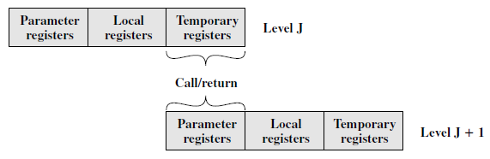
Design Issues of RISC (Cont’d…..)
2. Register Window: (Cont’d….)
Overlapping Register Windows

Slide 12
Design Issues of RISC (Cont’d…..)
3. Compiler based Register Optimization:
To optimize the use of registers, the approach taken is as follows:
Each program quantity that is a candidate for residing in a register is assigned to a symbolic or virtual register.
The compiler then maps the unlimited number of symbolic registers into a fixed number of real registers.
Symbolic registers whose usage does not overlap can share the same real register.
If in a particular portion of the program, there are more quantities to deal with than real registers, then some of the quantities are assigned to the memory location.

Slide 13
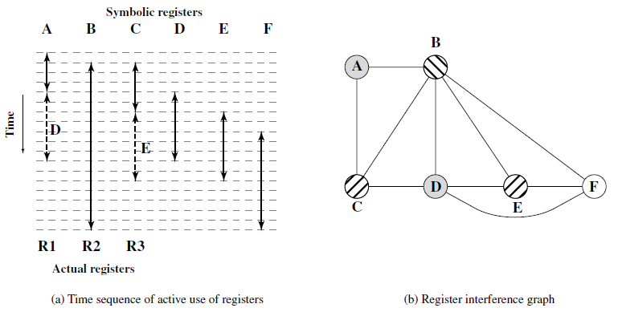
Design Issues of RISC (Cont’d…..)
3. Compiler based Register Optimization: (Cont’d….)
The technique most commonly used in RISC compiler is known as graph colouring.

Slide 14
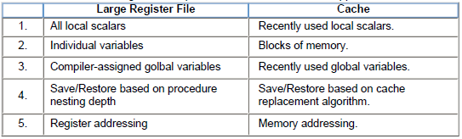
Large Register file versus cache

Slide 15
Introduction to pipelining
Pipelining is a technique of decomposing a sequential process into sub-operations, with each sub-process being executed in a special dedicated segment that operates concurrently with all other segments.
Conventional Sequential Execution
1
2
3
4
5
6
7
8
9
10
11
12
I1
F1
D1
E1
W1
I2
F2
D2
E2
W2
F3
D3
E3
W3
Pipelined Execution
1
2
3
4
5
6
7
8
I1
F1
D1
E1
W1
I2
F2
D2
E2
W2
F3
D3
E3
W3

Slide 16
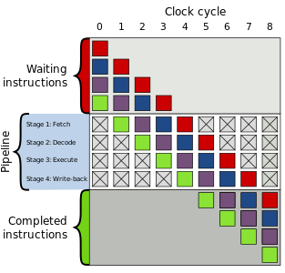
Introduction to pipelining: (Cont’d…..)

Slide 17
Four Stage Pipeline
F: Fetch, Read the instruction from the memory
D: Decode, decode the instruction and fetch the source operand (S)
E: Operate, perform the operation
W: Write, store the result in the destination location.
Step | 1 | 2 | 3 | 4 | 5 | 6 | 7 | 8 | 9
1 | F1 | D1 | E1 | W1
2 |  | F2 | D2 | E2 | W2
3 |  |  | F3 | D3 | E3 | W3
4 |  |  |  | F4 | D4 | E4 | W4
5 |  |  |  |  | F5 | D5 | E5 | W5
6 |  |  |  |  |  | F6 | D6 | E6 | W6
Timing diagram for 4- stage instruction pipeline

Slide 18
Instruction Execution in a Four Stage Pipeline
Fetch instruction from Memory
Decode instruction
Yes
Branch
No
Execute instruction
Interrupt
handling
Yes
Interrupt
No
Update PC
Write the result in destination
Empty Pipe
Flow-chart

Slide 19
Six Stage Pipelining Instruction Execution
Decomposition of the instruction execution:
Fetch Instruction (FI): Read the next expected instruction into a buffer
Decode Instruction (DI) : Determine the opcode and the operands Specifiers
Calculate Operand (CO): Calculate the effective address of each source operand. This may involve displacement, register indirect, indirect, or other forms of address calculation

Slide 20
Six Stage Pipelining Instruction Execution (Cont’d…..)
Decomposition of the instruction execution:
Fetch Operands(FO): Fetch each operand from memory. Operands in registers need not be fetched
Execute Instruction (EI):Perform the indicated operation and store the result, if any, in the specified destination operand location
Write Operand(WO): Store the result in memory.

Slide 21
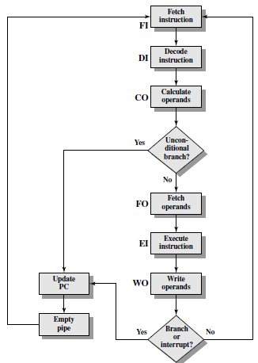
Instruction Execution in a Six Stage Pipeline
Flow-chart

Slide 22
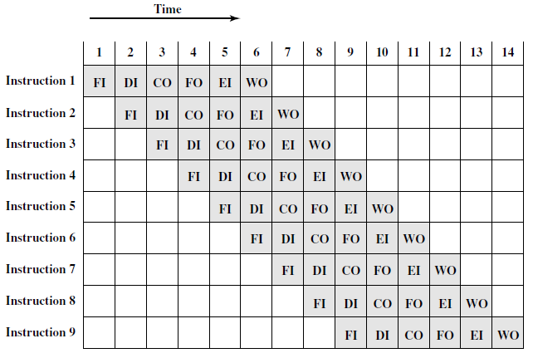
Timing diagram of Six stage Pipelining
Timing Diagram for Instruction Pipeline Operation

